Slide 1
Coconino Amateur Radio Club
Flagstaff, AZ

Slide 2
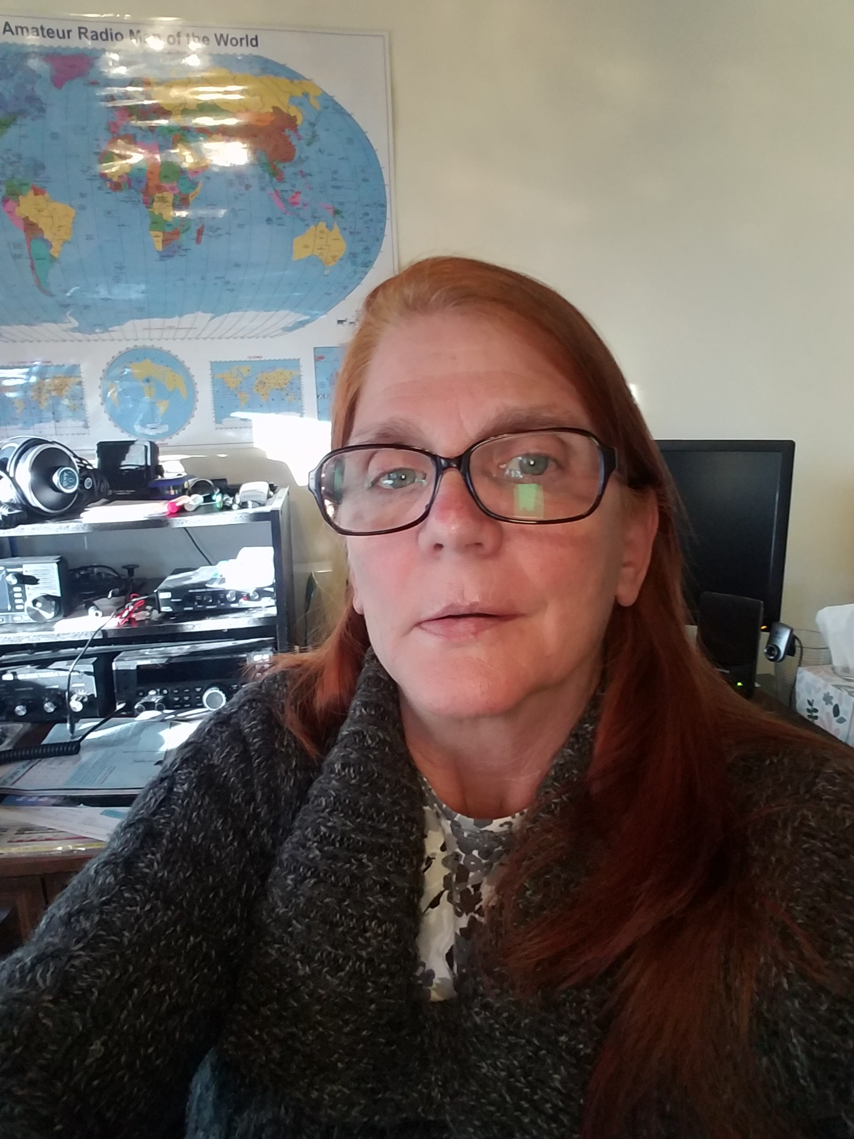
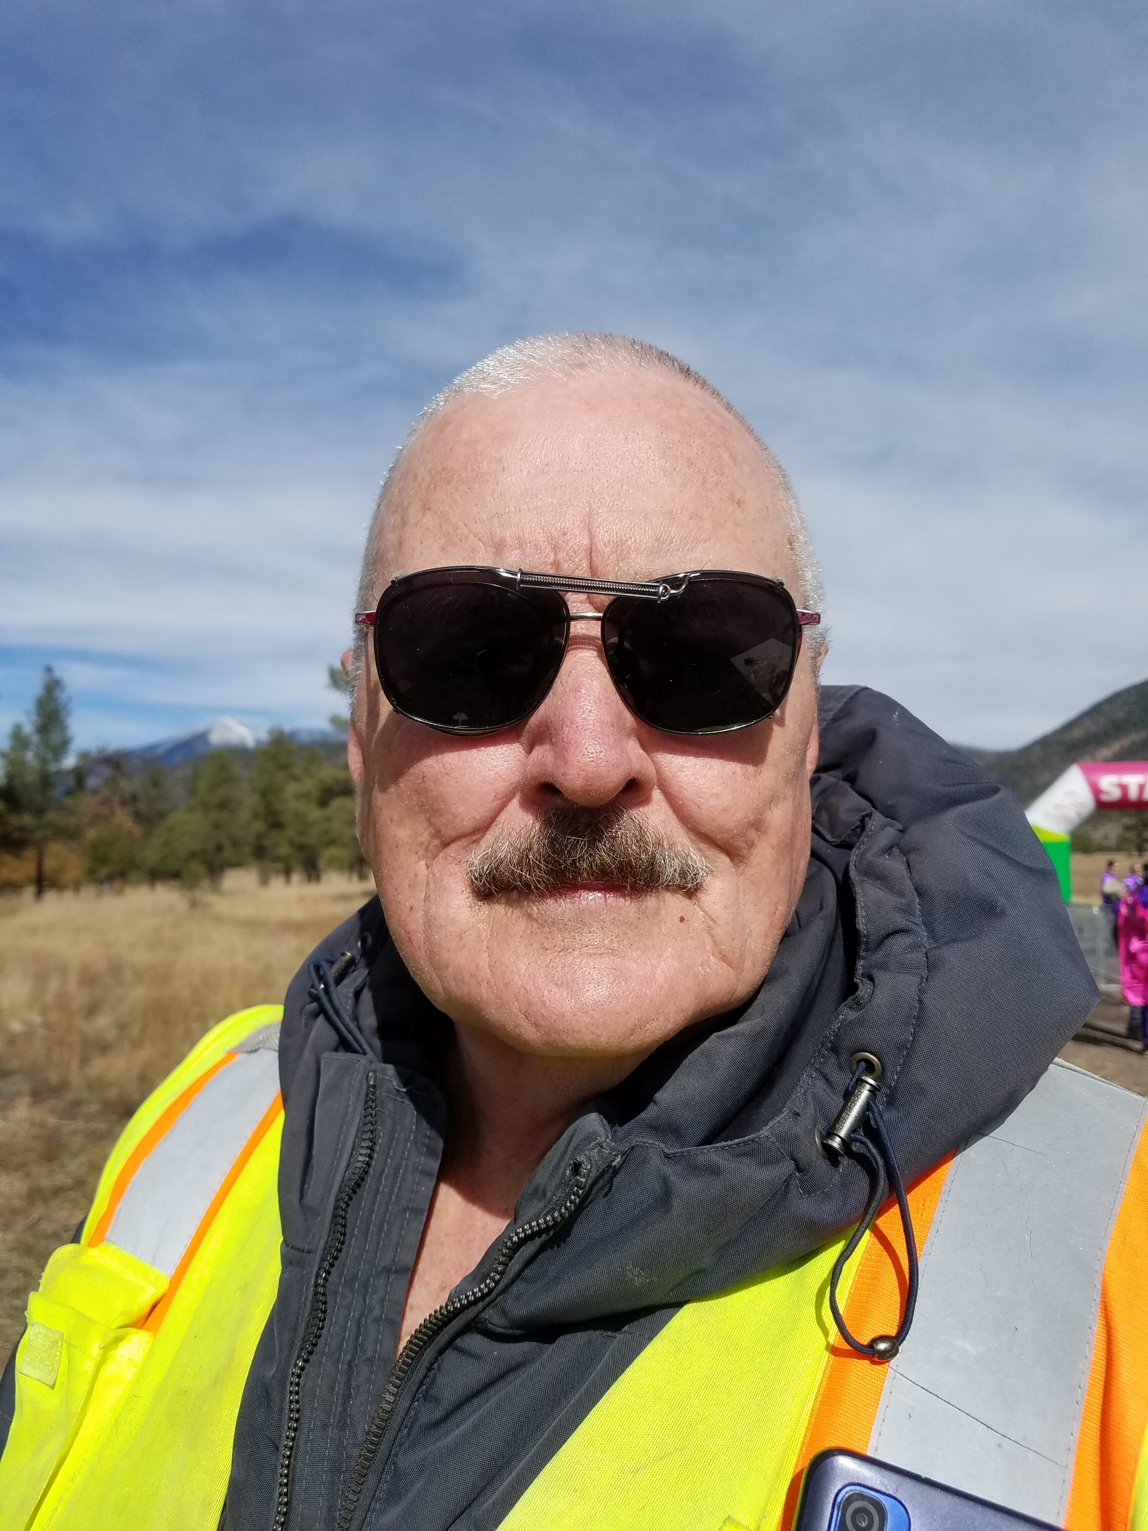
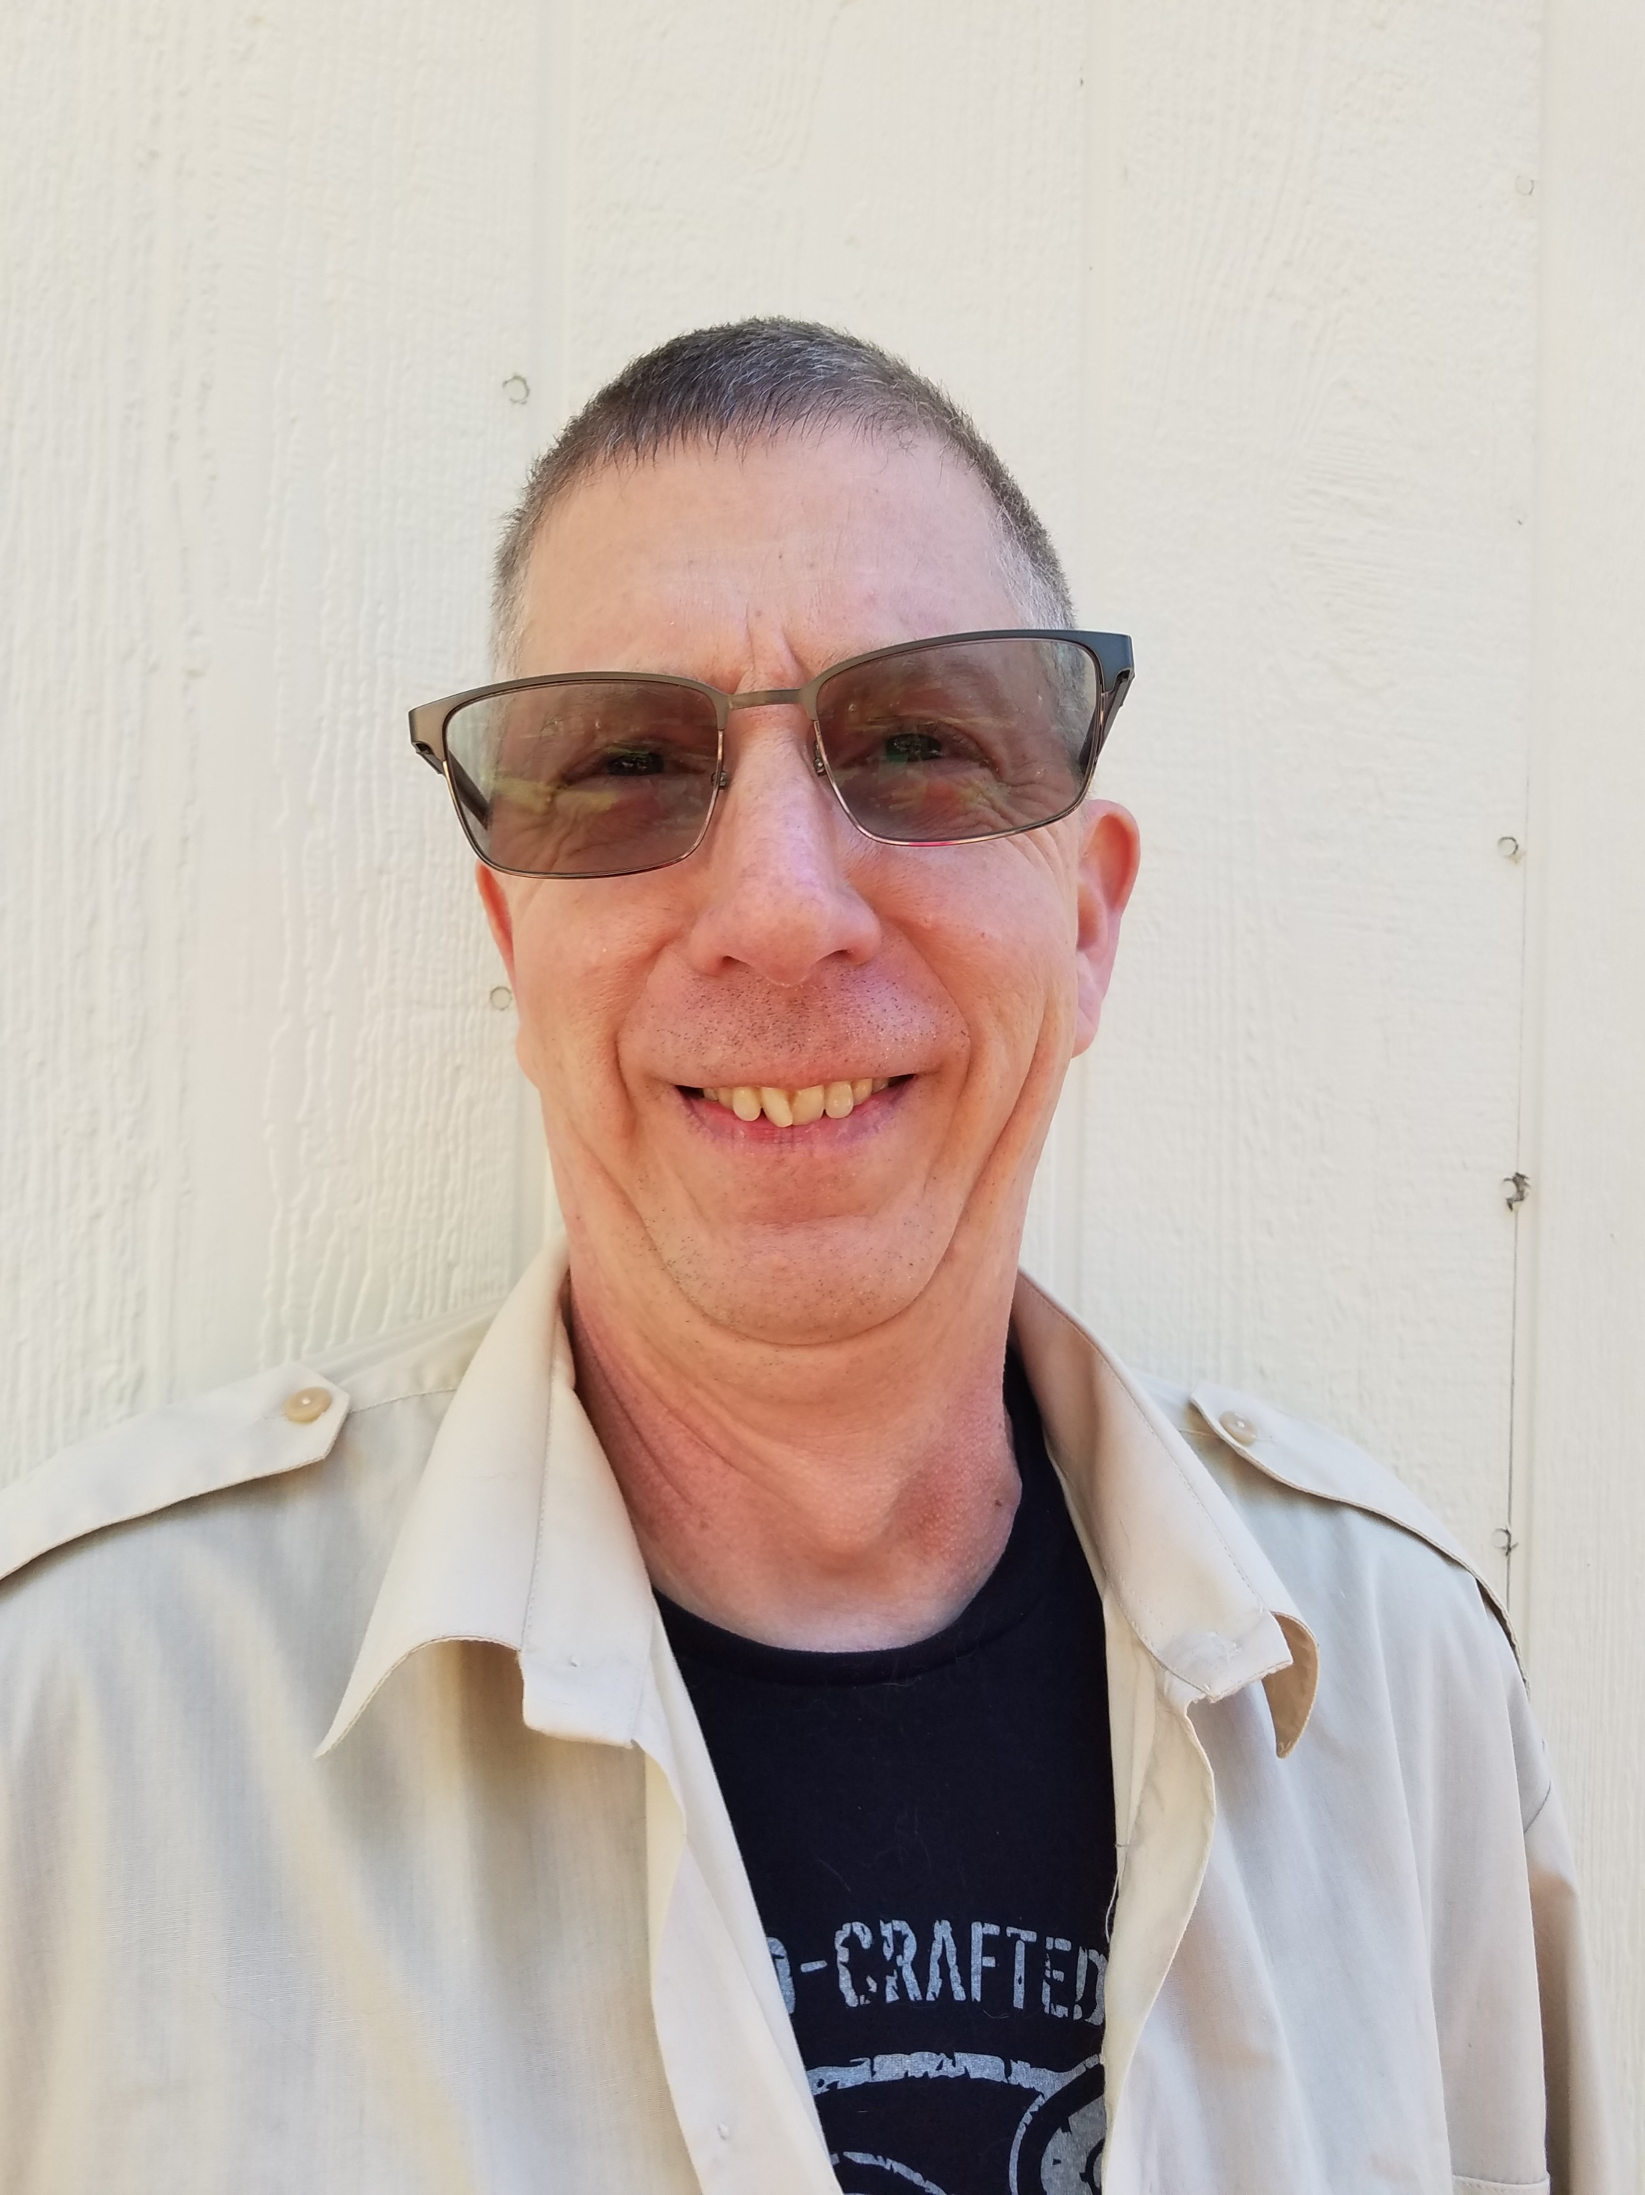
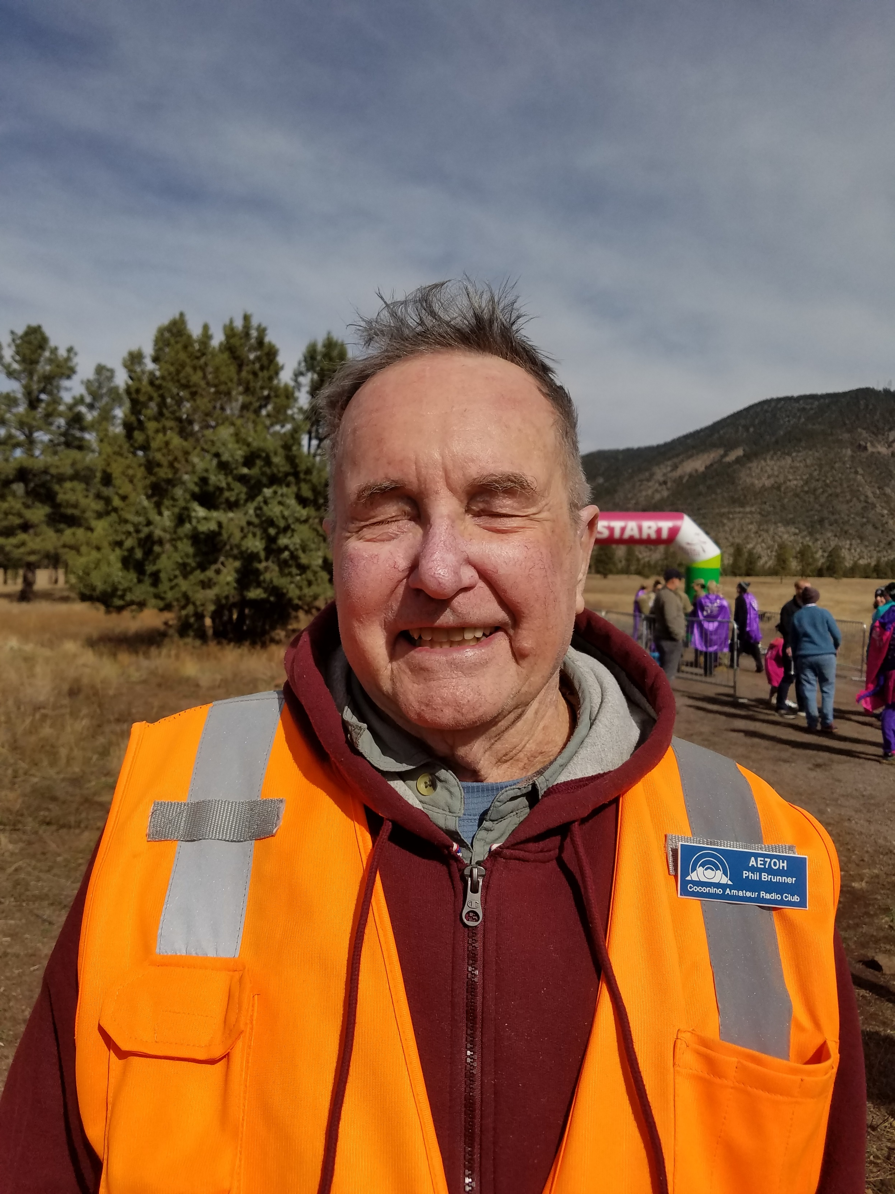
Club Officers
Janice Enloe
KI6WCK
President
Glen Davis
KG7YDJ
Vice-President
Dan Shearer
N7YIQ
Secretary
Phil Brunner
AE7OH
Treasurer

Slide 3
Meeting Attendance October 13 2022
Janice KI6WCK
Dan N7YIQ
Joe W7LUX
Glen KG7YDJ
Phil AE7OH
Bobbi W6HQJ
Al AB6VO
Morgan KI7WTS
John N7MLS
Mark WB8VWC

Slide 4
Secretary’s Report: Dan Shearer, N7YIQ
Minutes of the Coconino Amateur Radio Club- 10/13/2022
Meeting called to order at 1906 hours on Zoom via a virtual environment by Pres Janice KI6WCK. Roll was obtained via a check-in while online. Introductions. 10 Members.
President’s Report: Intros - Janice. There will be an antenna building event at Janice’s place this Sunday. We had our first freeze last night. The club will not be supporting the Flagstaff Marathon this Saturday as we struggle to get staff. The remaining October events we may not support as well.
Vice-President’s Report: Glen stated that the Great Shakeout is October 20th. 1015 start with a 1000 check in. Check ins are via simplex. November 5th is Girls on the Run at Buffalo Park. We need help for the event – contact Glen via email. It’s getting cold so keep your go bags ready. Keep stuff in your vehicles for emergencies. Treasurer’s Report for 1 October 2022
Income $ 0
Expenses $ 205.84
– reimbursement for expenses for 3 meetings and 2 breakfasts
Balance on 9/1/2022 ………………..………………..…………………………… $5962.75
Income …………………………………………..…………………………………….….… $ 0.00
Expense …………………………………………………………………………….……... $ 205.84
Ending Balance on 10/1/2022 …..……..…...…………………………………. $5756.91
----------------------------------------------------------------------------------------
Motion to accept Glen KG7YDJ – 2nd Al AB6VO - Motion passed.
Secretary's Report:. The minutes were sent by Dan to the CARC Members only email list. No changes proposed or suggested for last month’s minutes. A motion by to accept the minutes by Morgan KI7WTS. 2nd by Phil AE7OH – Motion passed.
Old Business: December 10th – Christmas Party
Antenna Building Party this Sunday the 16th – Tape Measure Beams for the Fox hunt on Nov 12th.
22nd Breakfast at Janice’s place
Girls on the Run event is upcoming.
Skywarn on the 10th of December.
Looking to do POTA, SOTA, IOTA, BOTA, LOTA. We are looking to stay active over the Winter months. San Francisco RC an event this weekend.
No events scheduled after the Christmas Party.
New Business:
Al to create a survey to poll the membership on activities and participation. 6 or so questions to determine meeting time and location and what a member wants in the club.
Nets are needing control operators.
POTA and SOTA are the hot things in Ham Radio right now. Maybe we can do one of these once a month.
Boy Scout Jamboree is upcoming and Ham Radio is a part of it.
ARES Joe stated that we had 369 hours for the month with all of the runs and events. The Shakeout exercise will be done via e-power and on simplex frequencies. Nothing else to report. For the Williams tornado we were on stand by but not called. Glen with a discussion about ARES exercises – who gets to participate – tabletop exercises. John stated that there are links that we could use – RimLink. Janice stated to add question on access to Elden repeaters as part of the survey.
Discussion
ARES and Skywarn nets to be combined as one net on Wednesday evening. Repeater Links as part of the net discussion. A request to the ARA would be needed if we are using other links. Possible net for members to participate on Mondays for RimLink. Changes will be made for next week – Glen will send an email.
50/50 – No drawing this month.
Adjourn
Glen KG7YDJ moved to close the meeting – Joe W7LUX 2nd. Passed without objection @ 2023
Respectfully Submitted
Dan Shearer – N7YIQ Secretary

Slide 5
Treasurer’s Report: Phil Brunner, AE7OH
Starting Balance 10/1/2022: $5756.91
Income: $ 0
Expenses: $ 0
Ending Balance 11/1/2022: $5756.91
Membership: 52
Life-time Members: 3
Vote to accept:

Slide 6
Website and eMailing List
Cocoradio.club- Phil and Janice, update
CARC email list- Barbara Brunner, W6HQJ

Slide 7
Nets:
ARES/Skywarn Net, every Wednesday @1900, ARA repeater 146.980 PL 162.2, negative offset
RACES Net, every Sunday @0730, HF 3990 ± for traffic
CW Practice Net, ZOOM
RimLink Net, every Monday @ 1900, John Nelson Net control

Slide 8
Old Business:
Yavapai Trailer- Joe Hobart
Yuma Hamfest 2023 Canceled- venue change and lack of volunteers

Slide 9
New Business:
2023 Calendar of Events review- vote in December 2022
Day and time for general business meeting- Remain in 2nd Thursday or move to another day and time?
New events for 2023- in upcoming slides

Slide 10
Proposed Calendar for 2023
January 12: General Business Meeting
January 14: Breakfast Social 50/50 raffle
January 28/29: Winter Field- Phil Brunner
February 9: General Business Meeting
February 11: Breakfast Social 50/50 raffle
March 9: General Business Meeting
March 11: Breakfast Social 50/50 raffle
April: STEM TBD
April 13: General Business Meeting
April 15: Breakfast Social 50/50 raffle
May 11: General Business Meeting
May 13: Breakfast Social 50/50 raffle
June 3: Sacred Mtn Prayer Run- Dan Shearer
June 8: General Business Meeting
June 10: Club Picnic 50/50 raffle
June 24/25: Field Day
July 4: Munds Park Parade
July 8: Breakfast Social 50/50 raffle
July 13: General Business Meeting
August 5: Flag2GC Bike Ride- Andrew, WA7DPS
August 10: General Business Meeting
August 12: BB/BS Half Marathon
September 4: Williams Labor Day Run- Glen Davis
September 14: General Business Meeting
September 16/17: Stagecoach 100 Run
September 23: End of Summer Picnic 50/50 raffle
October 12: General Business Meeting
October : Soulstice Run- BB/BS- TBD- Bill Smith
November TBD: Girls on the Run- Glen Davis
November 9: General Business Meeting
November 11: Breakfast Social 50/50 raffle
December 3: Skywarn Recognition
December 9: Holiday Party/Pot Luck; 50/50 raffle

Slide 11
Public Service Events- who benefits?
STEM Event- Science, Technology, Engineering, and Math event- K-12 graders
SkyWarn- National Weather Service
Sacred Mountain Prayer Run- NACA programs i.e. Reach UR Life Suicide Prevention, Wellness Center, Lasting Indigenous Family Enrichment, and Pathways Programs
Flagstaff to Grand Canyon Bike Ride- Fundraiser for Marine Corp Charities
Big Brother/Big Sister Half Marathon- Big Brother/Big Sister organization
Stagecoach 100 Trail Run- Fundraiser for the Az Trails Association
Labor Day Run, Williams- Proceeds benefit the Williams Lions Club vision services program
Soulstice Run- Big Brother/Big Sister organization
Girls on the Run- local girls Grades 3-8, program fostering physical, emotional, social health of girls to help them navigate life events in a positive manner

Slide 12
New for 2023-
Technical Talk with Joe Hobart, W7LUX
Half hour program @1830 before the General Business Meeting
Digital Radio
What’s new in HAM radio
Antenna talk
Understanding the Bands
Q&A: Got a technical question? Joe is here to help

Slide 13
More New for 2023
POTA group- Group and Club-wide events- Scott Downard
SOTA group- Group and Club-wide events
Antenna Building with Ken Held
Fox Hunt (Hidden Transmitter Hunt)- Morgan Conklin
RimLink Net, format TBD,- John Nelson

Slide 14
Additional Activities to Consider
CW (Morse Code) Training Net
Road Rally
Digital Mode Training and Practice
HAM Swapmeet
License Exams
License/Upgrade Classes
Once a month happy hour social
Club campout weekend. Bring radios out, set up- Scott Downard

Slide 15
Upcoming Events: Events in the next three months
November 5: Girls on the Run Event
November 10 @1900: General Business Meeting
November 12 @1000: Fox Hunt/Hidden Transmitter Hunt. Lunch social following
December 3: SkyWarn Recognition Day
December 10: Holiday Party/Pot Luck 50/50 raffle @1100-1500
December CW Refresher and Practice- Jacob Miller, KI7WNS
January 12 2023: CARC General Business Meeting
January 14 2023: Breakfast Social @0900
January 28/29 2023: Winter Field Day

Slide 16
ARES Report- Joe Hobart W7LUX
Great American Shakeout
Nets- ARES, SkyWarn, RimLink
POTA, SOTA, IOTA activations
Public Service Events
Emergency Operations Events
Traffic Net
RACES Net
MARS
Winter Field Day/ June Field Day
Motorist assist
Contesting/DX contacts

Slide 17
Final Comments/Open Forum
Any additional topics for discussion?
Facebook Page- Move to Slack?

Slide 18
Next Meeting
January 12 @1900, ZOOM

Slide 19
Meeting Adjourned
Good Night
73’s

